Slide 1



Real time Analytics with Apache Kafka and Spark October 2014 Meetup Organized by Big Data Hyderabad. http://www.meetup.com/Big-Data-Hyderabad/
Rahul Jain
@rahuldausa

Slide 2
About Me
Big data/Search Consultant
8+ years of learning experience.
Worked (got a chance) on High volume distributed applications.
Still a learner (and beginner)

Slide 3
Quick Questionnaire
How many people know/work on Scala ?
How many people know/work on Apache Kafka?
How many people know/heard/are using Apache Spark ?

Slide 4
What we are going to learn/see today ?
Apache Zookeeper (Overview)
Apache Kafka – Hands-on
Apache Spark – Hands-on
Spark Streaming (Explore)

Slide 5

Apache Zookeeper TM

Slide 6

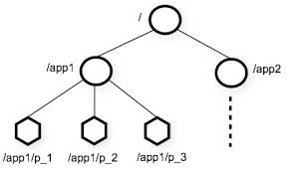
What is Zookeeper
An Open source, High Performance coordination service for distributed applications
Centralized service for
Configuration Management
Locks and Synchronization for providing coordination between distributed systems
Naming service (Registry)
Group Membership
Features
hierarchical namespace
provides watcher on a znode
allows to form a cluster of nodes
Supports a large volume of request for data retrieval and update
http://zookeeper.apache.org/
Source : http://zookeeper.apache.org

Slide 7
Zookeeper Use cases
Configuration Management
Cluster member nodes Bootstrapping configuration from a central source
Distributed Cluster Management
Node Join/Leave
Node Status in real time
Naming Service – e.g. DNS
Distributed Synchronization – locks, barriers
Leader election
Centralized and Highly reliable Registry

Slide 8
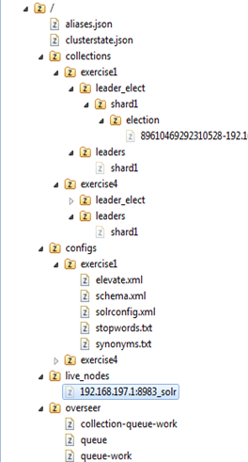
Zookeeper Data Model
Hierarchical Namespace
Each node is called “znode”
Each znode has data(stores data in byte[] array) and can have children
znode
Maintains “Stat” structure with version of data changes , ACL changes and timestamp
Version number increases with each changes

Slide 9
Let’s recall basic concepts of Messaging System

Slide 10
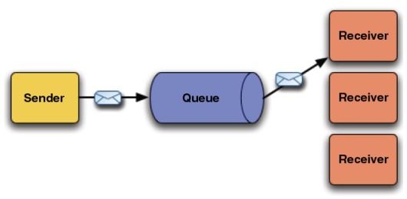
Point to Point Messaging (Queue)
Credit: http://fusesource.com/docs/broker/5.3/getting_started/FuseMBStartedKeyJMS.html

Slide 11
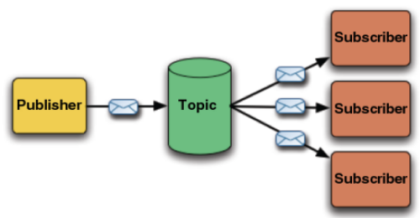
Publish-Subscribe Messaging (Topic)
Credit: http://fusesource.com/docs/broker/5.3/getting_started/FuseMBStartedKeyJMS.html

Slide 12
Apache Kafka

Slide 13
Overview
An apache project initially developed at LinkedIn
Distributed publish-subscribe messaging system
Designed for processing of real time activity stream data e.g. logs, metrics collections
Written in Scala
Does not follow JMS Standards, neither uses JMS APIs
Features
Persistent messaging
High-throughput
Supports both queue and topic semantics
Uses Zookeeper for forming a cluster of nodes (producer/consumer/broker)
and many more…
http://kafka.apache.org/

Slide 14
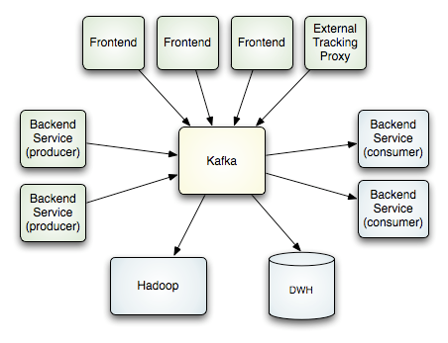
How it works
Credit : http://kafka.apache.org/design.html

Slide 15
Real time transfer
Broker does not Push messages to Consumer, Consumer Polls messages from Broker.
Zookeeper
Update Consumed
Message offset
Consumer1
(Group1)
get Kafka broker address
Queue
Topology
Consumer2
(Group1)
Producer
Kafka Broker
Consumer3
(Group2)
Kafka Broker
Streaming
Topic
Topology
Fetch messages
Consumer4
(Group2)

Slide 16
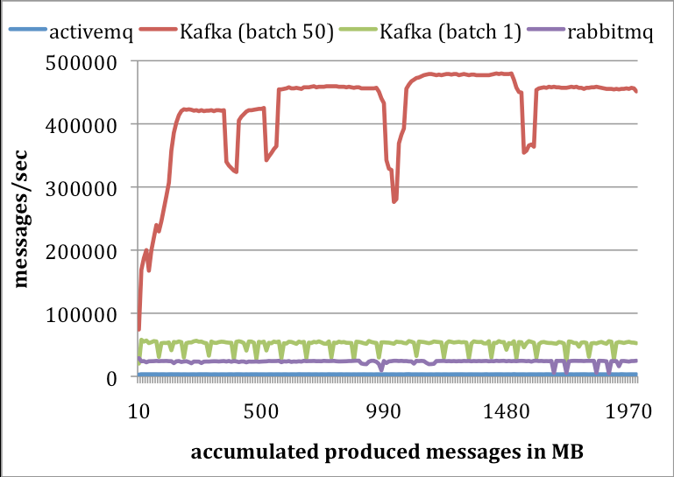
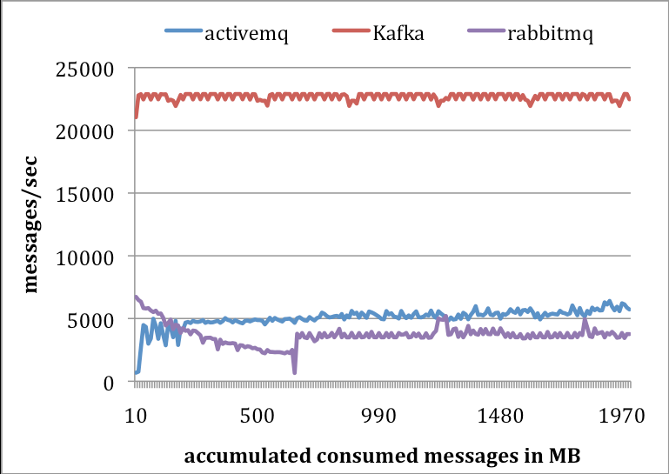
Performance Numbers
Producer Performance
Consumer Performance
Credit : http://research.microsoft.com/en-us/UM/people/srikanth/netdb11/netdb11papers/netdb11-final12.pdf

Slide 17
About Apache Spark
Initially started at UC Berkeley in 2009
Fast and general purpose cluster computing system
10x (on disk) - 100x (In-Memory) faster
Most popular for running Iterative Machine Learning Algorithms.
Provides high level APIs in
Java
Scala
Python
Integration with Hadoop and its eco-system and can read existing data.
http://spark.apache.org/

Slide 18
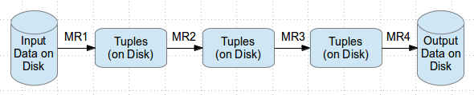
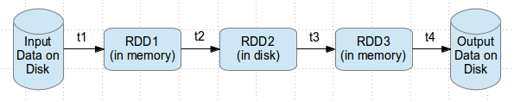
So Why Spark ?
Most of Machine Learning Algorithms are iterative because each iteration can improve the results
With Disk based approach each iteration’s output is written to disk making it slow
Hadoop execution flow
Spark execution flow
http://www.wiziq.com/blog/hype-around-apache-spark/

Slide 19
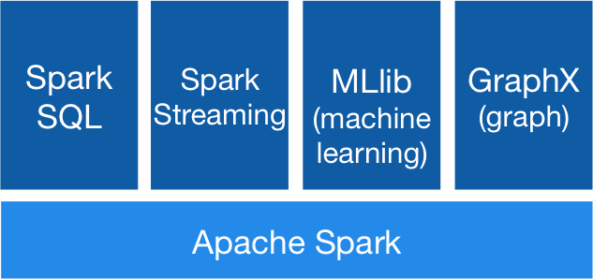
Spark Stack
Spark SQL
For SQL and unstructured data processing
MLib
Machine Learning Algorithms
GraphX
Graph Processing
Spark Streaming
stream processing of live data streams
http://spark.apache.org

Slide 20
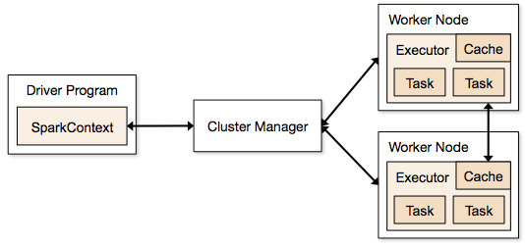
Execution Flow
http://spark.apache.org/docs/latest/cluster-overview.html

Slide 21
Terminology
Application Jar
User Program and its dependencies except Hadoop & Spark Jars bundled into a Jar file
Driver Program
The process to start the execution (main() function)
Cluster Manager
An external service to manage resources on the cluster (standalone manager, YARN, Apache Mesos)
Deploy Mode
cluster : Driver inside the cluster
client : Driver outside of Cluster

Slide 22
Terminology (contd.)
Worker Node : Node that run the application program in cluster
Executor
Process launched on a worker node, that runs the Tasks
Keep data in memory or disk storage
Task : A unit of work that will be sent to executor
Job
Consists multiple tasks
Created based on a Action
Stage : Each Job is divided into smaller set of tasks called Stages that is sequential and depend on each other
SparkContext :
represents the connection to a Spark cluster, and can be used to create RDDs, accumulators and broadcast variables on that cluster.

Slide 23
Resilient Distributed Dataset (RDD)
Resilient Distributed Dataset (RDD) is a basic Abstraction in Spark
Immutable, Partitioned collection of elements that can be operated in parallel
Basic Operations
map
filter
persist
Multiple Implementation
PairRDDFunctions : RDD of Key-Value Pairs, groupByKey, Join
DoubleRDDFunctions : Operation related to double values
SequenceFileRDDFunctions : Operation related to SequenceFiles
RDD main characteristics:
A list of partitions
A function for computing each split
A list of dependencies on other RDDs
Optionally, a Partitioner for key-value RDDs (e.g. to say that the RDD is hash-partitioned)
Optionally, a list of preferred locations to compute each split on (e.g. block locations for an HDFS file)
Custom RDD can be also implemented (by overriding functions)

Slide 24
Cluster Deployment
Standalone Deploy Mode
simplest way to deploy Spark on a private cluster
Amazon EC2
EC2 scripts are available
Very quick launching a new cluster
Apache Mesos
Hadoop YARN

Slide 25
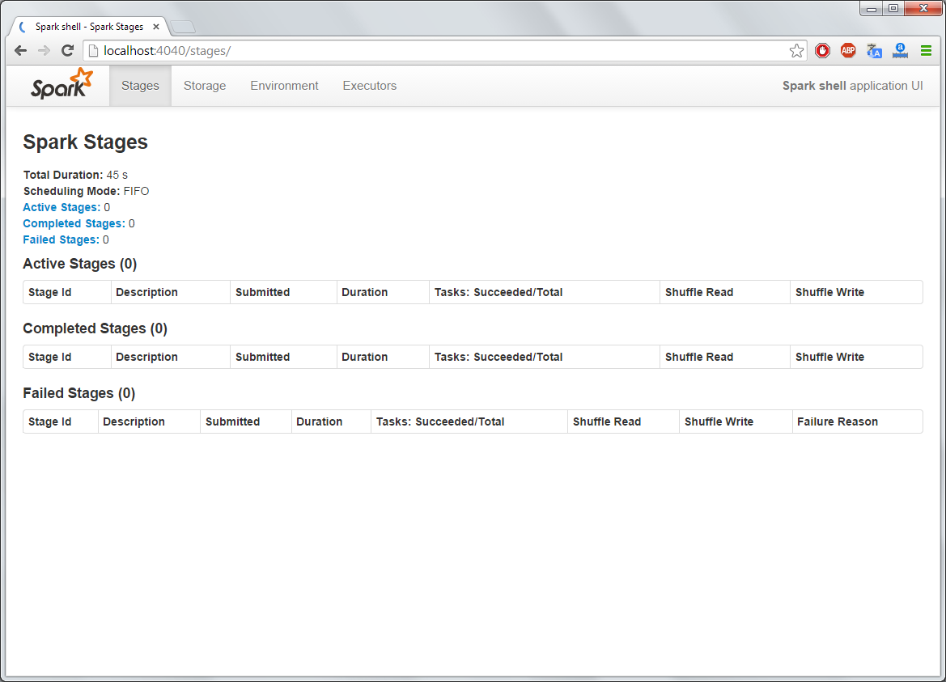
Monitoring

Slide 26
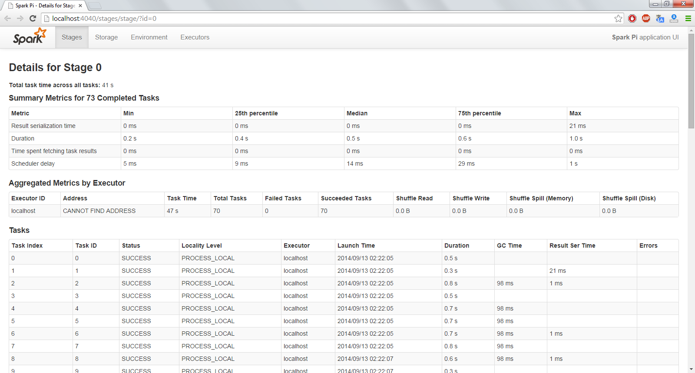
Monitoring – Stages

Slide 27
Let’s start getting hands dirty

Slide 28
Kafka Installation
Download
http://kafka.apache.org/downloads.html
Untar it
> tar -xzf kafka_<version>.tgz
> cd kafka_<version>

Slide 29
Start Servers
Start the Zookeeper server
> bin/zookeeper-server-start.sh config/zookeeper.properties
Pre-requisite: Zookeeper should be up and running.
Now Start the Kafka Server
> bin/kafka-server-start.sh config/server.properties

Slide 30
Create/List Topics
Create a topic
> bin/kafka-topics.sh --create --zookeeper localhost:2181 --replication-factor 1 --partitions 1 --topic test
List down all topics
> bin/kafka-topics.sh --list --zookeeper localhost:2181
Output: test

Slide 31
Producer
Send some Messages
> bin/kafka-console-producer.sh --broker-list localhost:9092 --topic test
Now type on console:
This is a message
This is another message

Slide 32
Consumer
Receive some Messages
> bin/kafka-console-consumer.sh --zookeeper localhost:2181 --topic test --from-beginning
This is a message
This is another message

Slide 33
Multi-Broker Cluster
Copy configs
> cp config/server.properties config/server-1.properties
> cp config/server.properties config/server-2.properties
Changes in the config files.
config/server-1.properties:
broker.id=1
port=9093
log.dir=/tmp/kafka-logs-1
config/server-2.properties:
broker.id=2
port=9094
log.dir=/tmp/kafka-logs-2

Slide 34
Start with New Nodes
Start other Nodes with new configs
> bin/kafka-server-start.sh config/server-1.properties &
> bin/kafka-server-start.sh config/server-2.properties &
Create a new topic with replication factor as 3
> bin/kafka-topics.sh --create --zookeeper localhost:2181 --replication-factor 3 --partitions 1 --topic my-replicated-topic
List down the all topics
> bin/kafka-topics.sh --describe --zookeeper localhost:2181 --topic my-replicated-topic
Topic:my-replicated-topic PartitionCount:1 ReplicationFactor:3 Configs:
Topic: my-replicated-topic Partition: 0 Leader: 1 Replicas: 1,2,0 Isr: 1,2,0

Slide 35
Let’s move to Apache Spark

Slide 36
Spark Shell
./bin/spark-shell --master local[2]
The --master option specifies the master URL for a distributed cluster, or local to run locally with one thread, or local[N] to run locally with N threads. You should start by using local for testing.
./bin/run-example SparkPi 10
This will run 10 iterations to calculate the value of Pi

Slide 37
Basic operations…
scala> val textFile = sc.textFile("README.md")
textFile: spark.RDD[String] = spark.MappedRDD@2ee9b6e3
scala> textFile.count() // Number of items in this RDD
ees0: Long = 126
scala> textFile.first() // First item in this RDD
res1: String = # Apache Spark
scala> val linesWithSpark = textFile.filter(line => line.contains("Spark"))
linesWithSpark: spark.RDD[String] = spark.FilteredRDD@7dd4af09
Simplier - Single liner:
scala> textFile.filter(line => line.contains("Spark")).count() // How many lines contain "Spark"?
res3: Long = 15

Slide 38
Map - Reduce
scala> textFile.map(line => line.split(" ").size).reduce((a, b) => if (a > b) a else b)
res4: Long = 15
scala> import java.lang.Math
scala> textFile.map(line => line.split(" ").size).reduce((a, b) => Math.max(a, b))
res5: Int = 15
scala> val wordCounts = textFile.flatMap(line => line.split(" ")).map(word => (word, 1)).reduceByKey((a, b) => a + b)
wordCounts: spark.RDD[(String, Int)] = spark.ShuffledAggregatedRDD@71f027b8
wordCounts.collect()

Slide 39
With Caching…
scala> linesWithSpark.cache()
res7: spark.RDD[String] = spark.FilteredRDD@17e51082
scala> linesWithSpark.count()
res8: Long = 15
scala> linesWithSpark.count()
res9: Long = 15

Slide 40
With HDFS…
val lines = spark.textFile(“hdfs://...”) val errors = lines.filter(line => line.startsWith(“ERROR”)) println(Total errors: + errors.count())

Slide 41
Standalone (Scala)
/* SimpleApp.scala */ import org.apache.spark.SparkContext import org.apache.spark.SparkContext._ import org.apache.spark.SparkConf object SimpleApp {
def main(args: Array[String]) { val logFile = "YOUR_SPARK_HOME/README.md" // Should be some file on your system val conf = new SparkConf().setAppName("Simple Application") .setMaster(“local") val sc = new SparkContext(conf) val logData = sc.textFile(logFile, 2).cache() val numAs = logData.filter(line => line.contains("a")).count() val numBs = logData.filter(line => line.contains("b")).count() println("Lines with a: %s, Lines with b: %s".format(numAs, numBs)) } }

Slide 42
Standalone (Java)
/* SimpleApp.java */ import org.apache.spark.api.java.*; import org.apache.spark.SparkConf; import org.apache.spark.api.java.function.Function; public class SimpleApp {
public static void main(String[] args) {
String logFile = "YOUR_SPARK_HOME/README.md"; // Should be some file on your system SparkConf conf = new SparkConf().setAppName("Simple Application").setMaster("local"); JavaSparkContext sc = new JavaSparkContext(conf); JavaRDD<String> logData = sc.textFile(logFile).cache(); long numAs = logData.filter(new Function<String, Boolean>() { public Boolean call(String s) { return s.contains("a"); } }).count(); long numBs = logData.filter(new Function<String, Boolean>() { public Boolean call(String s) { return s.contains("b"); } }).count(); System.out.println("Lines with a: " + numAs + ", lines with b: " + numBs); } }

Slide 43
Job Submission
$SPARK_HOME/bin/spark-submit \ --class "SimpleApp" \ --master local[4] \ target/scala-2.10/simple-project_2.10-1.0.jar

Slide 44
Configuration
val conf = new SparkConf() .setMaster("local") .setAppName("CountingSheep") .set("spark.executor.memory", "1g")
val sc = new SparkContext(conf)

Slide 45
Let’s discuss
Real-time Clickstream Analytics

Slide 46
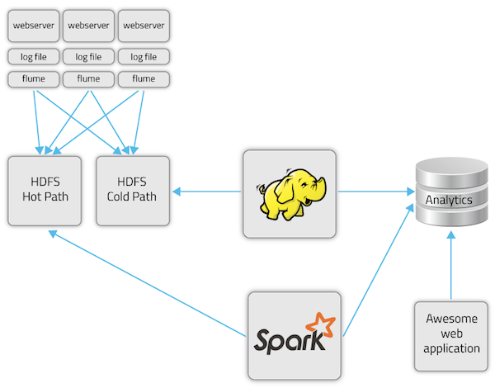
Analytics High Level Flow
A clickstream is the recording of the parts of the screen a computer user clicks on while web browsing.
http://blog.cloudera.com/blog/2014/03/letting-it-flow-with-spark-streaming/

Slide 47
Spark Streaming
Makes it easy to build scalable fault-tolerant streaming applications.
Ease of Use
Fault Tolerance
Combine streaming with batch and interactive queries.

Slide 48
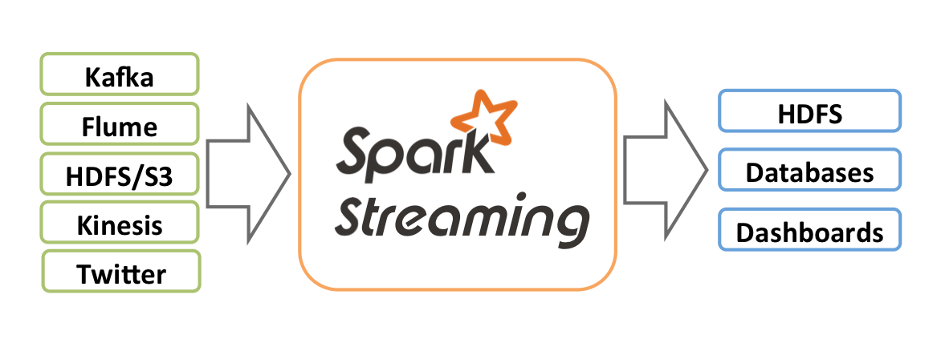
Support Multiple Input/Outputs
Credit : http://spark.apache.org

Slide 49
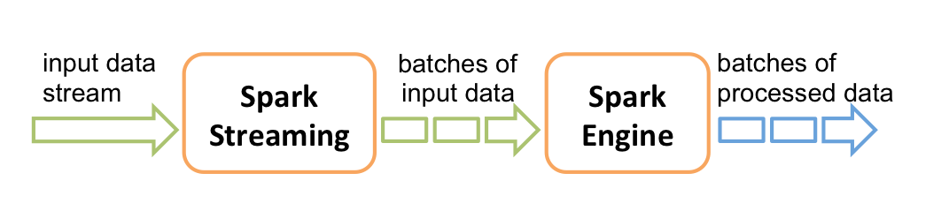
Streaming Flow
Credit : http://spark.apache.org

Slide 50
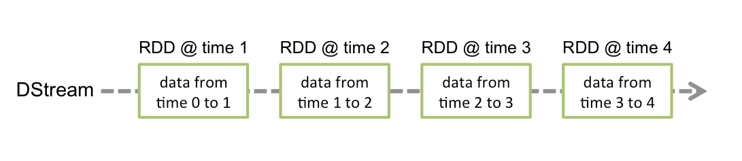
Spark Streaming Terminology
Spark Context
An object with configuration parameters
Discretized Steams (DStreams)
Stream from input sources or generated after transformation
Continuous series of RDDs
Input DSteams
Stream of raw data from input sources

Slide 51
Spark Context
SparkConf sparkConf = new SparkConf().setAppName(”PageViewsCount");
sparkConf.setMaster("local[2]");//running locally with 2 threads
// Create the context with a 5 second batch size
JavaStreamingContext jssc = new JavaStreamingContext(sparkConf, new Duration(5000));

Slide 52
Reading from Kafka Stream
int numThreads = Integer.parseInt(args[3]);
Map<String, Integer> topicMap = new HashMap<String, Integer>();
String[] topics = args[2].split(",");
for (String topic: topics) {
topicMap.put(topic, numThreads);
}
JavaPairReceiverInputDStream<String, String> messages =
KafkaUtils.createStream(jssc, <zkQuorum>, <group> , topicMap);

Slide 53
Processing of Stream
/**
* Incoming:
// (192.168.2.82,1412977327392,www.example.com,192.168.2.82)
// 192.168.2.82: key : tuple2._1()
// 1412977327392,www.example.com,192.168.2.82: value: tuple2._2()
*/
// Method signature: messages.map(InputArgs, OutputArgs)
JavaDStream<Tuple2<String, String>> events = messages.map(new Function<Tuple2<String, String>, Tuple2<String, String>>() {
@Override
public Tuple2<String, String> call(Tuple2<String, String> tuple2) {
String[] parts = tuple2._2().split(",");
return new Tuple2<>(parts[2], parts[1]);
}
});
JavaPairDStream<String, Long> pageCountsByUrl = events.map(new Function<Tuple2<String,String>, String>(){
@Override
public String call(Tuple2<String, String> pageView) throws Exception {
return pageView._2();
}
}).countByValue();
System.out.println("Page counts by url:");
pageCountsByUrl.print();

Slide 54
Thanks! @rahuldausa on twitter and slideshare http://www.linkedin.com/in/rahuldausa
Join us @ For Solr, Lucene, Elasticsearch, Machine Learning, IR
http://www.meetup.com/Hyderabad-Apache-Solr-Lucene-Group/
http://www.meetup.com/DataAnalyticsGroup/
Join us @ For Hadoop, Spark, Cascading, Scala, NoSQL, Crawlers and all cutting edge technologies.
http://www.meetup.com/Big-Data-Hyderabad/

